Slide 1
Project - 3
Global Energy Production and Consumption
Data Visualization Track
By Krinal, Christine, Nafis

Slide 2
Project Overview
The Energy Data Visualization Project contains three interactive visualizations related to global energy consumption:
Global Primary Energy Consumption by Source
Per Capita Primary Energy Consumption by Source
Share of Electricity Production from Renewables
Our goal is to automate the data ingestion process, expose this data through a Flask API, and present it on an intuitive HTML frontend for easy exploration.

Slide 3
Ethical Considerations
This project prioritizes ethical data usage and transparency. All datasets used are sourced from reputable institutions and publicly available data repositories to ensure accuracy and avoid unauthorized use. Additionally, visualizations are designed to present data without misleading representations, focusing on clarity and avoiding distortions that could misinform viewers. Efforts have been made to respect privacy and avoid inclusion of personally identifiable information (PII) by utilizing only aggregated data. In terms of accessibility, interactive visualizations include labels and hover text to improve interpretability for a wide audience.

Slide 4
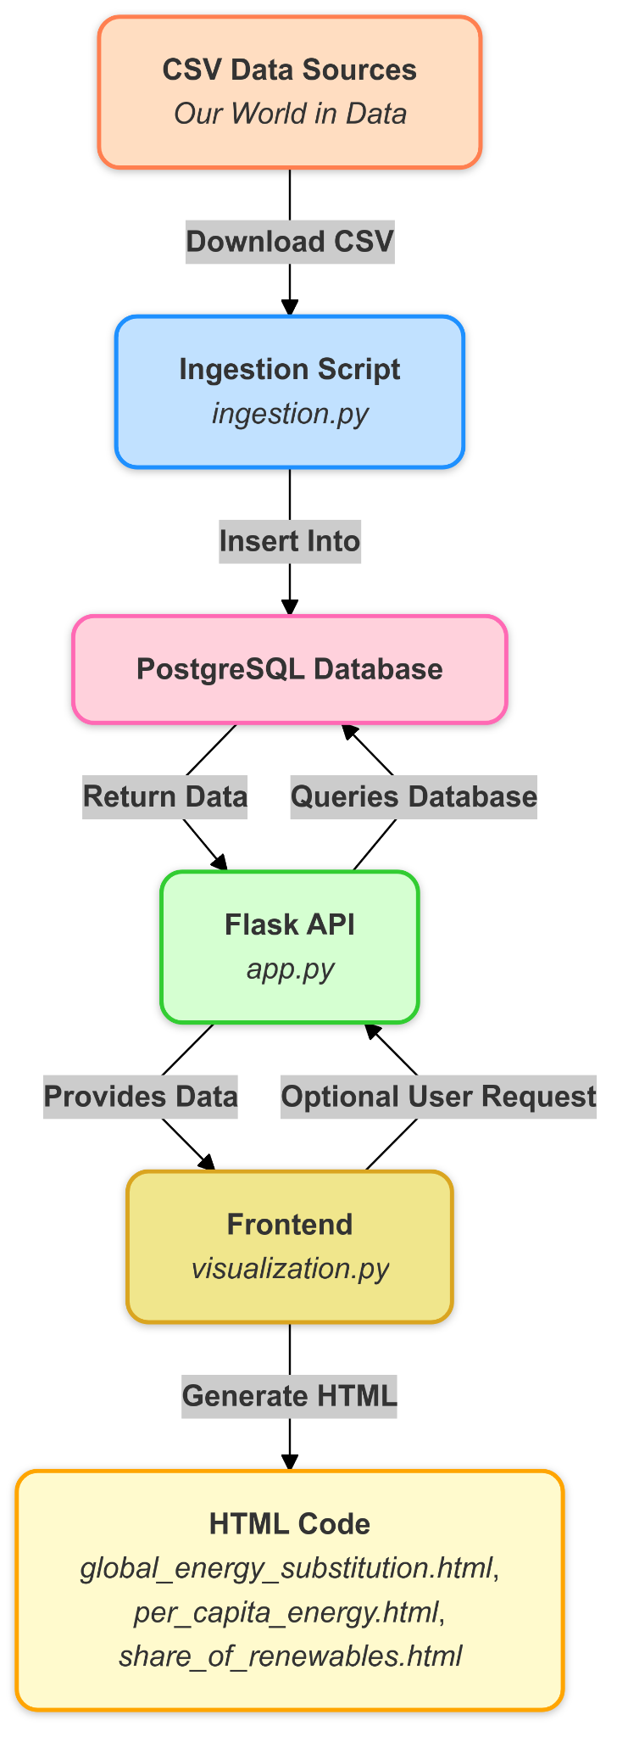
System Architecture Diagram

Slide 5
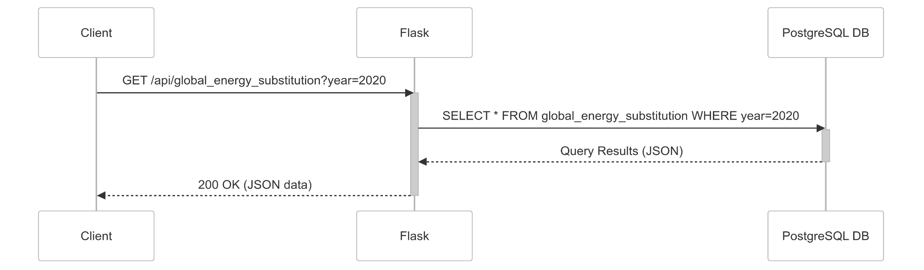
API Interaction

Slide 6
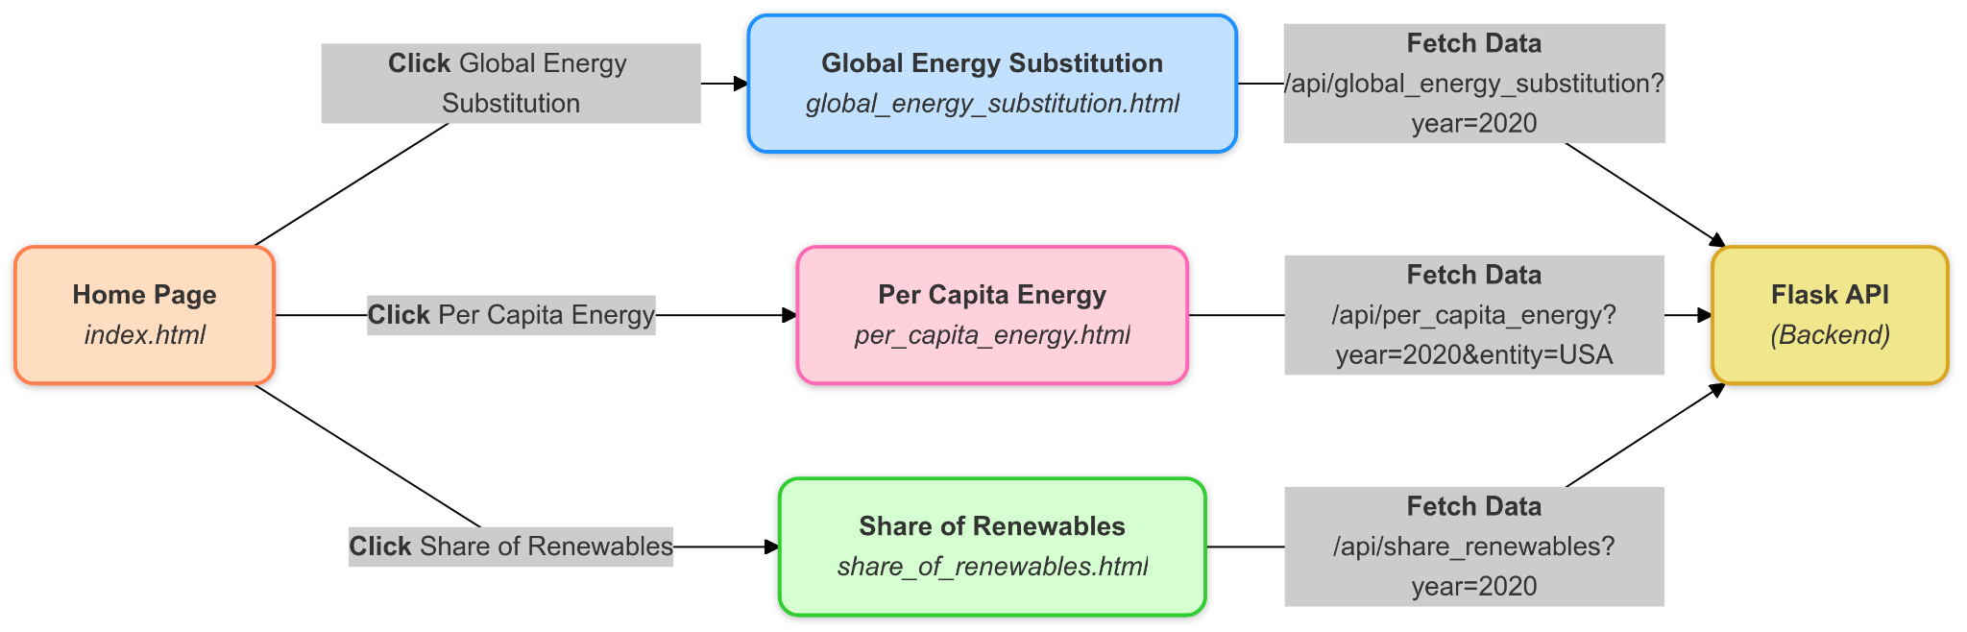
Frontend Navigation/Interaction Diagram

Slide 7
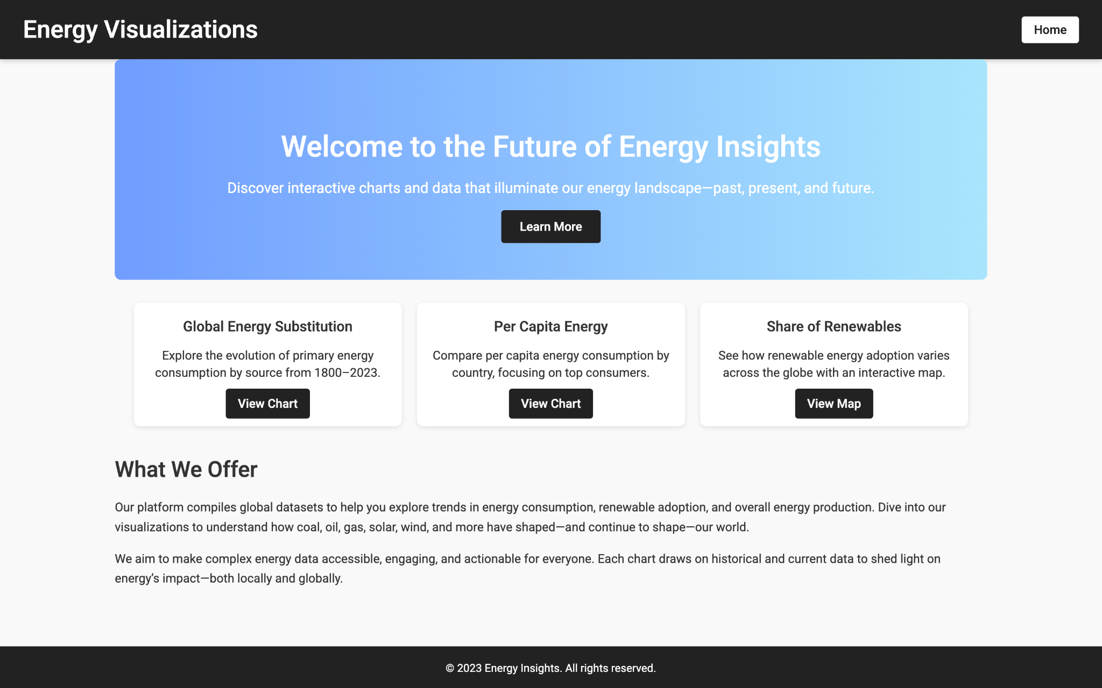
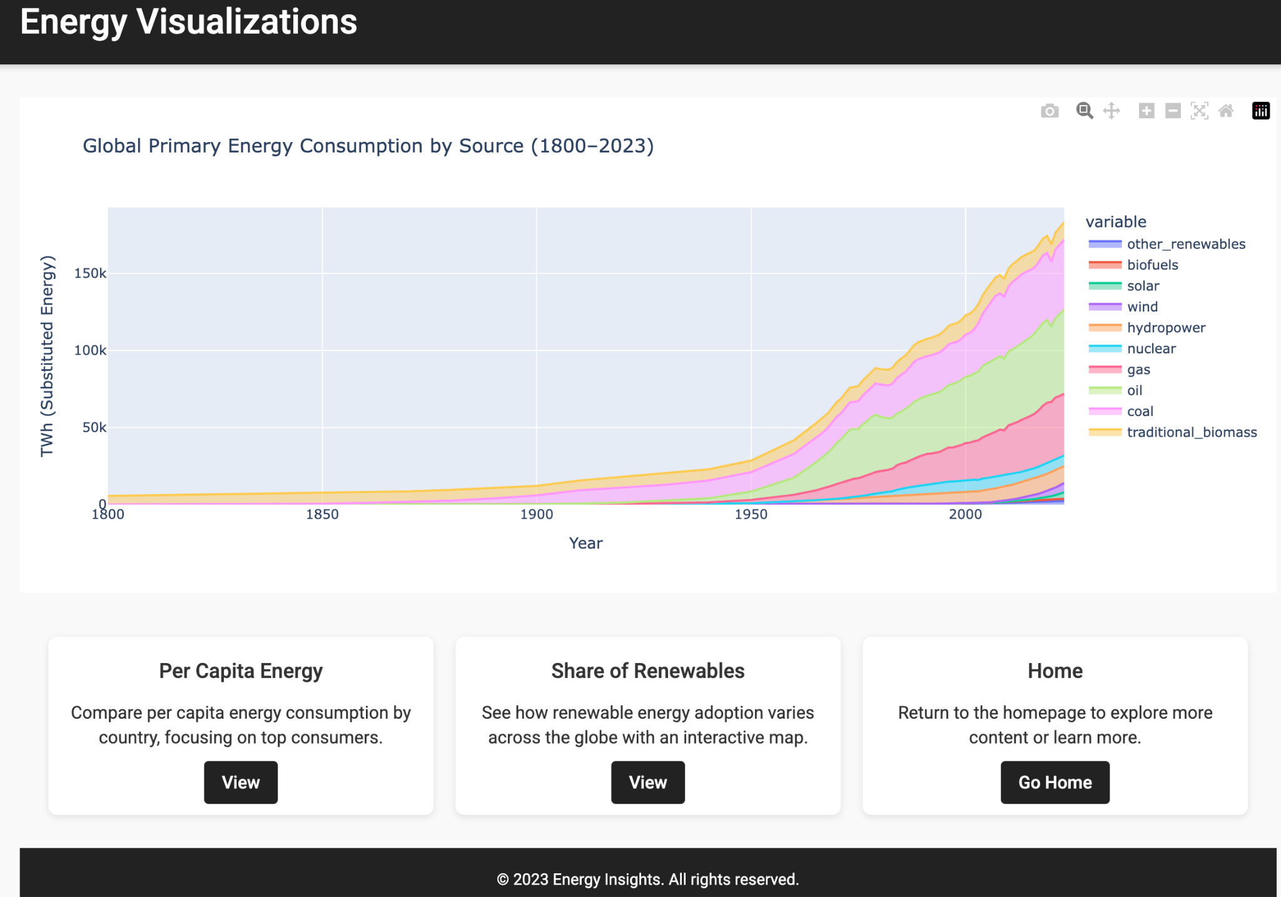
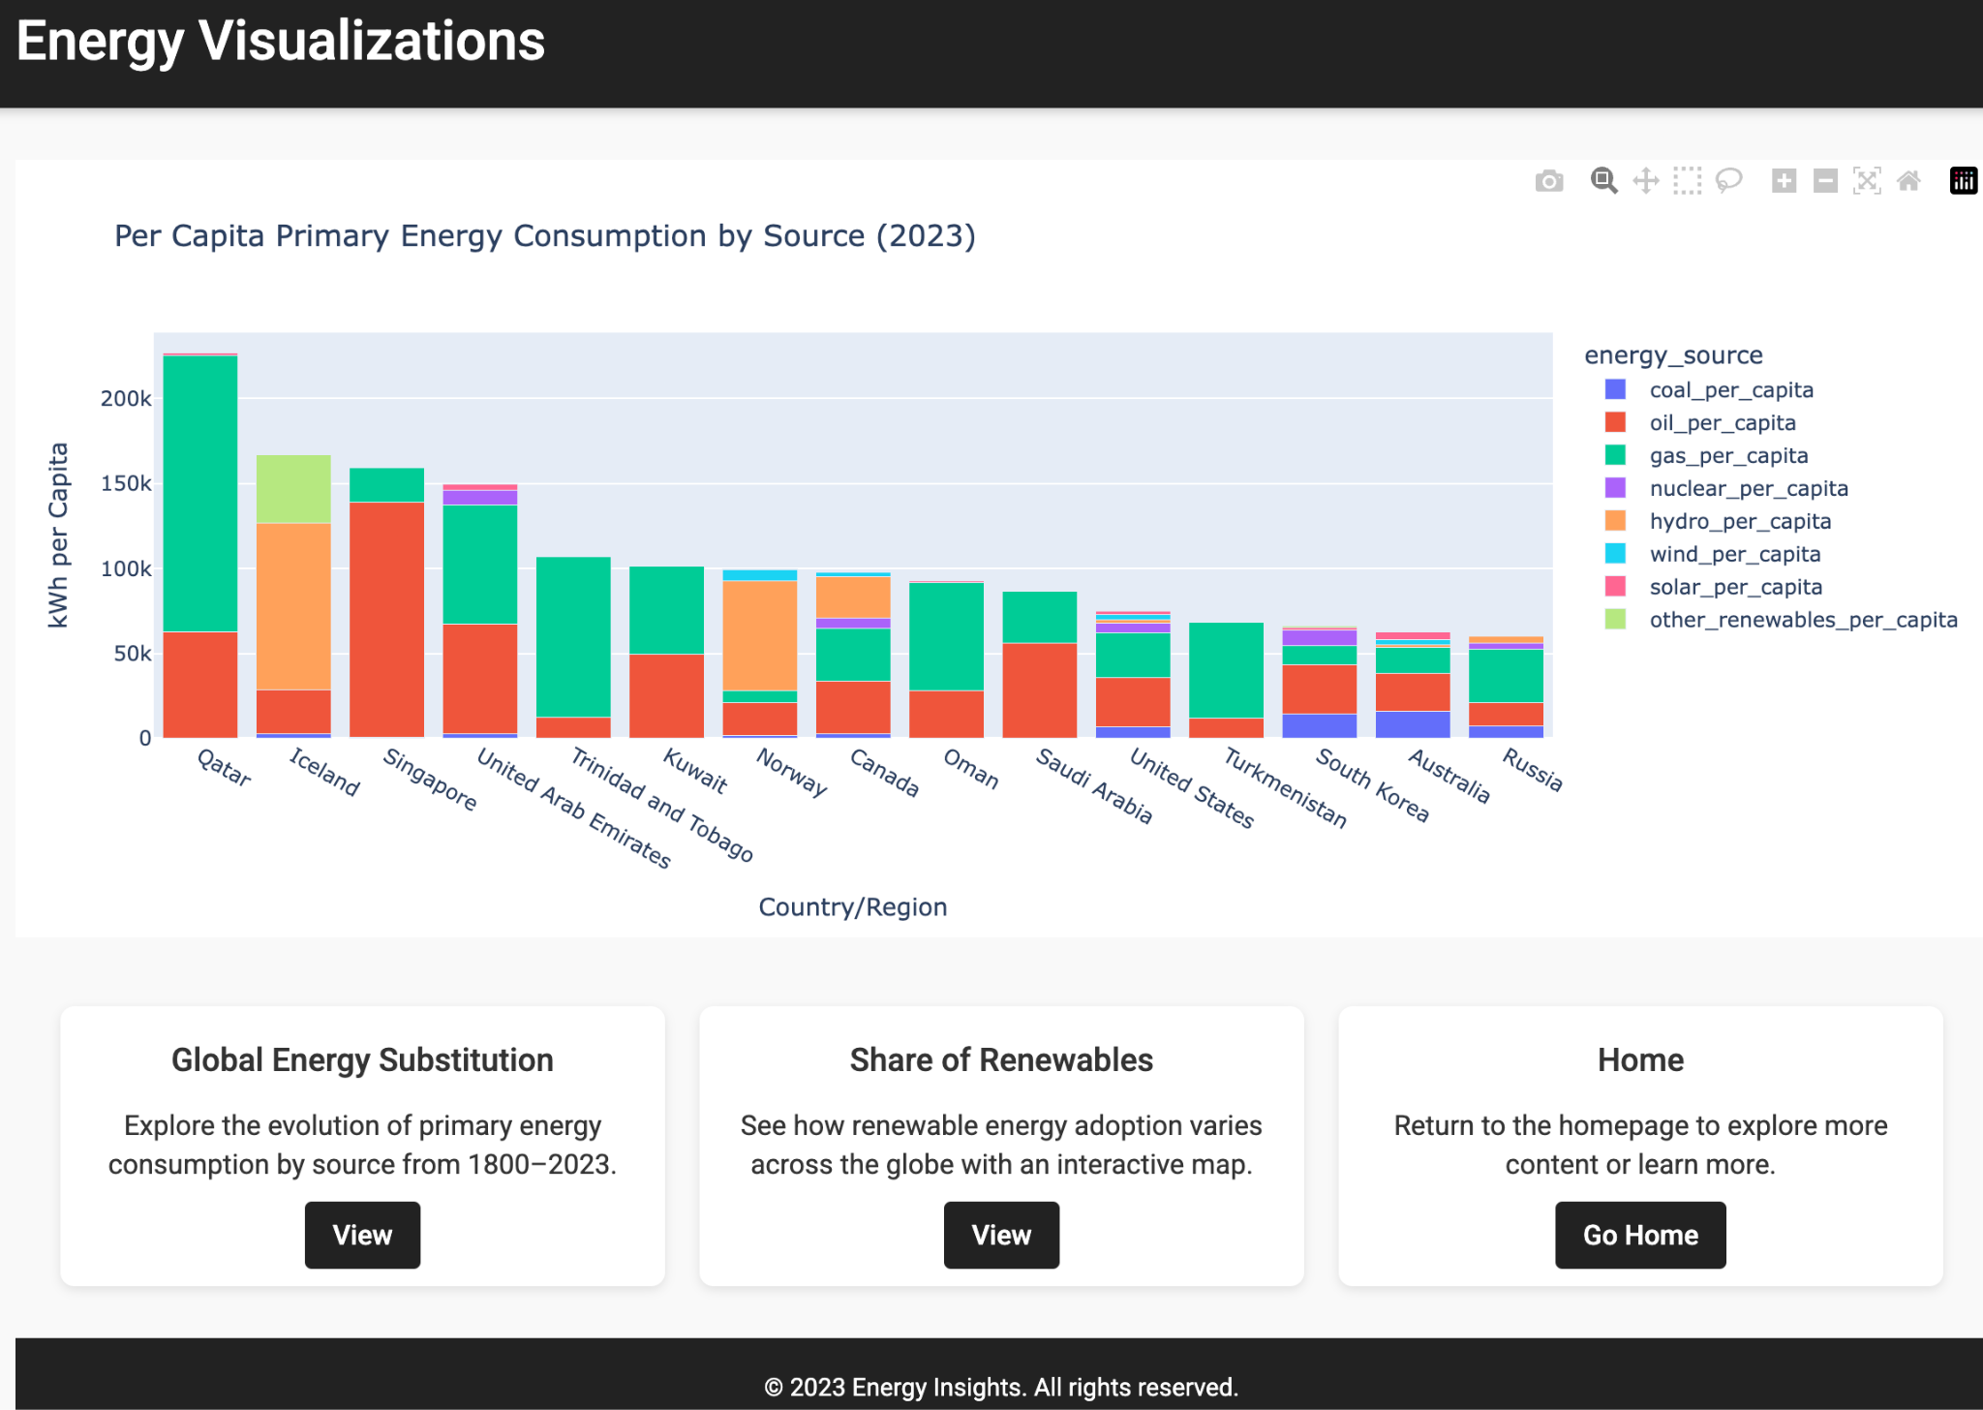
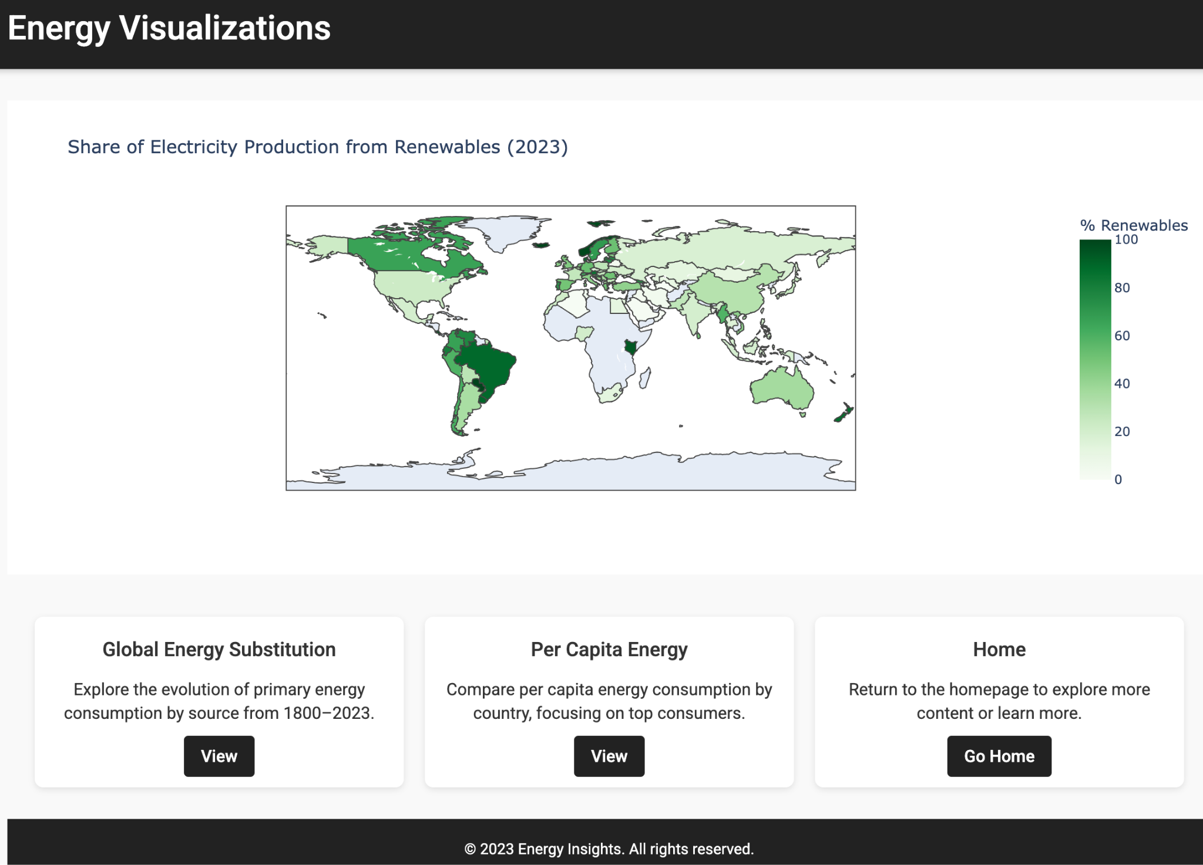

Slide 8
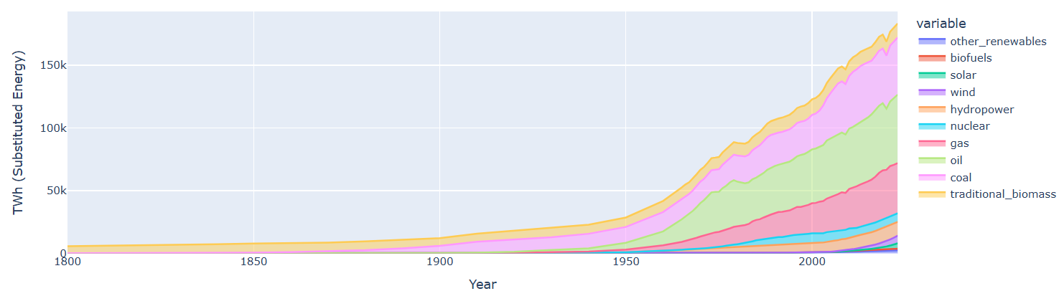
Global Primary Energy Consumption by Source (1800–2023)
Key Insights:
Historical Growth: Global primary energy consumption has surged, especially post-1950, due to industrialization and population growth.
Dominance of Fossil Fuels: Despite the rise of renewables, fossil fuels (oil, coal, gas) continue to dominate.
Recent Trends: In 2023, fossil fuel consumption reached record highs, pushing global emissions over 40 gigatonnes of CO₂.
Energy Emissions Hit Record High
Interpretation:
Energy transition efforts remain insufficient to curb rising emissions.
Developing nations’ increasing energy demands highlight a need for tailored solutions.
Supporting Data:
13% Growth in Renewable Generation (2023): Read More
Europe’s Fossil Fuel Reduction: Read More
Fossil Fuel Demand Growth in India and China: Read More
Recommendations:
Invest in large-scale renewable infrastructure projects.
Support developing nations with green funding initiatives.
Enhance global cooperation to meet decarbonization targets.

Slide 9
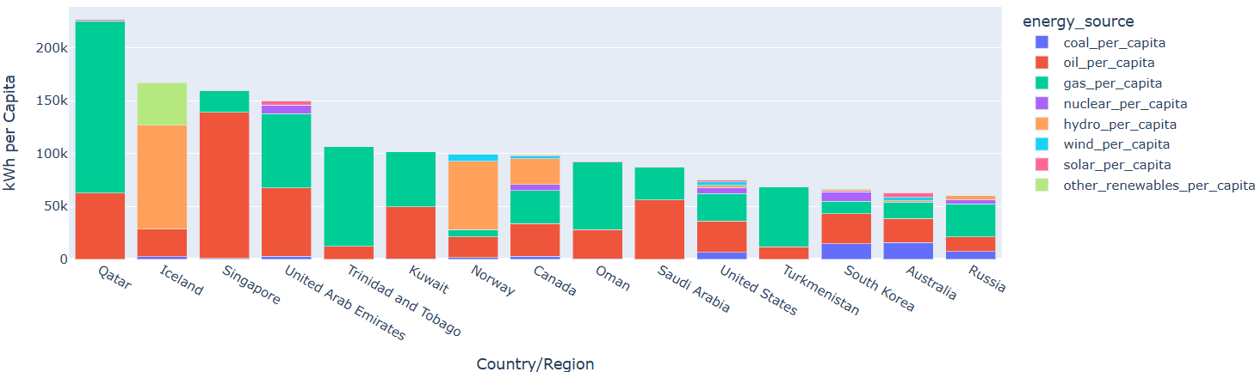
Per Capita Primary Energy Consumption by Source (2023)
Key Insights:
Countries like Qatar, Iceland, and Singapore have high per capita energy use.
Fossil fuels dominate in Qatar and Saudi Arabia.
Iceland and Norway have high shares of renewable energy due to geothermal and hydropower.
Fossil Fuels: Is a Decrease in Demand in Sight?
Interpretation:
Resource availability drives per capita consumption patterns.
Nations with renewable resources benefit from lower emissions and energy independence.
Supporting Data:
Qatar’s per capita energy consumption: Read More
Iceland’s renewable share: Read More
Recommendations:
Promote energy efficiency programs in high-consumption nations.
Expand renewable energy investments, especially in resource-rich regions.
Develop long-term policies to reduce per capita fossil fuel reliance.

Slide 10
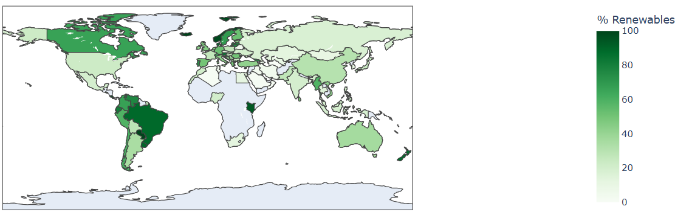
Share of Electricity Production from Renewables (2023)
Key Insights:
Latin American countries (e.g., Brazil) and Europe lead in renewable shares.
The U.S., Russia, and Middle East show slower adoption of renewable energy.
More Clean Energy is Needed
Interpretation:
Policy incentives and abundant renewable resources have boosted renewable adoption.
Slower adoption in other regions stems from limited infrastructure or political barriers.
Supporting Data:
Brazil’s renewable growth: Read More
Norway’s hydropower dominance: Read More
Recommendations:
Strengthen policy frameworks to incentivize renewable investments.
Invest in grid modernization and renewable energy storage.
Foster cross-border collaboration to share renewable best practices.

Slide 11
Thank You

